Slide 1
AI applications in Finance
Lecture 7
Introduction to Neural Networks
17-Dec-2020
Indranil Dutta

Slide 2
Recap
Self Organizing Maps (SOMs)
Reduce dimensionality
Project on a map
Unsupervised learning
Discover relationships
Example through code
Example through Simbrain.

Slide 3
Fun Fact(s) :
From McKinsey’s Risk Management Practice area
Applicable to Capital Markets (market place for long term debt and equity based instruments)
Machine learning can help in
Pricing
Valuation adjustment
Market Risk
Market volatility increased post COVID 19. (e.g. one US based firm $950 mill loss due to valuation adjustment
Traditional models unable to deal with market uncertainty.
How machine learning (neural network based) can help
Speed up calculations, reduce operational costs and do real time risk management.
Create more complex models and valuations with greater accuracy.
Deal with market ‘disruptions’ caused by events like COVID 19.
Source: McKInsey and Company – Risk Practice : Applying machine learning in capital markets: Pricing, valuation adjustments, and market risk, https://en.wikipedia.org/wiki/Capital_market

Slide 4
Agenda – Session 7
Introduction to Neural Designer
Case : Credit Card Fraud Detection.

Slide 5
Neural Designer

Slide 6
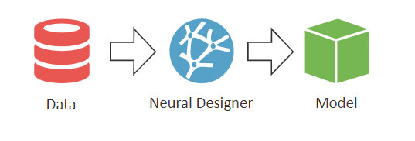
Neural Designer - Introduction
Available from https://www.neuraldesigner.com/
Download the one for the environment – Win 64 (around 414 MB)
Install and register using your Google credentials.
Password is sent to your Gmail account.
A tool to make neural network based predictive models
Data Preparation
Machine Learning
Model Preparation
Do not have to code or build network architecture
Results represented visually through dashboards, charts etc.
Source: https://www.neuraldesigner.com/learning/user-guide/what-is-neural-designer

Slide 7
Neural Designer - Introduction
Model types
Approximation
Classification
Data operations
Can work with many common datasets like csv etc.
Capable of finding correlations, outliers, data filtering
Network Architecture
Perceptron, probabilistic, scaling and un-scaling layers.
Different activation and scaling / un-scaling functions.
Source : https://www.neuraldesigner.com/learning/user-guide/technical-features

Slide 8
Neural Designer - Introduction
Training
Many loss measures like mean square error
Many optimization techniques like gradient decent etc.
Model deployment
Calculate output values
Get the mathematical model
Code in C and Python.
Source : https://www.neuraldesigner.com/learning/user-guide/technical-features

Slide 9
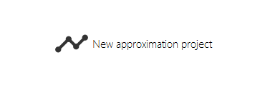
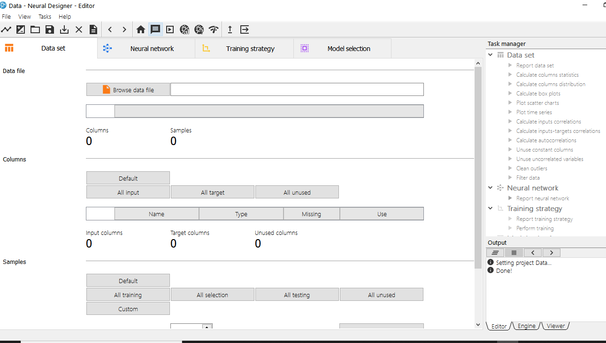
Neural Designer – Building Networks - Step 1
Create the project
Click on new approximation project
Save the project with same name as data file
Data file is data.csv
The application opens in the editor view
Source : https://www.neuraldesigner.com/learning/user-guide/design-a-neural-network#CreateApproximationProject

Slide 10
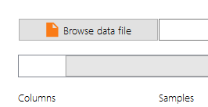
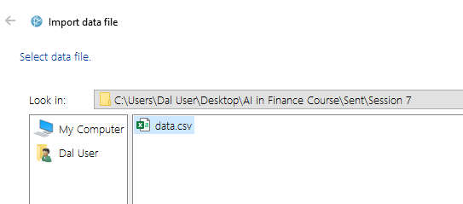
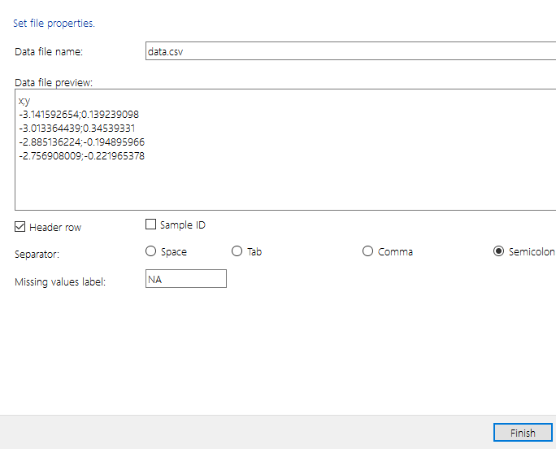
Neural Designer – Building Networks - Step 2a.
Get the data set
Browse for the data set
Select the data (csv) file and press next
See the file characteristics and press finish.
Source : https://www.neuraldesigner.com/learning/user-guide/design-a-neural-network#CreateApproximationProject

Slide 11
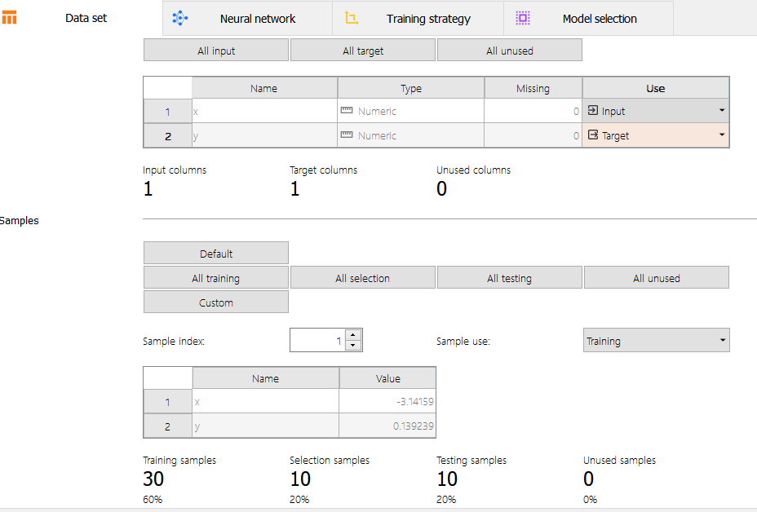
Neural Designer – Building Networks - Step 2b.
Examine the data set loaded
Confirm the input and target columns
Confirm sample size
Confirm sample selection
Confirm samples (%) to be used for
Training
Selection
Testing
Unused
Source : https://www.neuraldesigner.com/learning/user-guide/design-a-neural-network#CreateApproximationProject

Slide 12
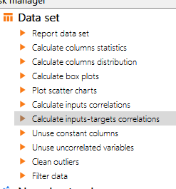
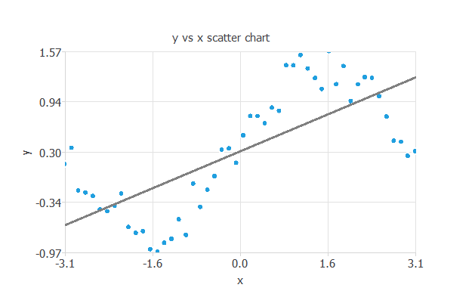
Neural Designer – Building Networks - Step 2c.
See relationships between columns
See graphs
Plot scatter charts
See correlations
Calculate inputs-target correlations
Source : https://www.neuraldesigner.com/learning/user-guide/design-a-neural-network#CreateApproximationProject

Slide 13

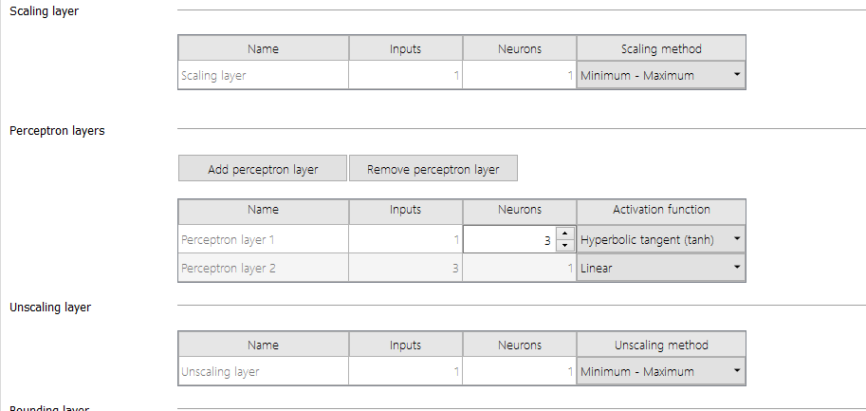
Neural Designer – Building Networks - Step 3a.
Build the network
Go to the network view
See the layers set up
See scaling method
See activation method
See un-scaling method
Source : https://www.neuraldesigner.com/learning/user-guide/design-a-neural-network#CreateApproximationProject

Slide 14

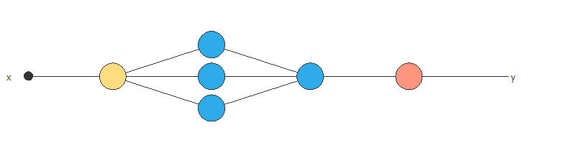
Neural Designer – Building Networks - Step 3b.
View the network
Go to the network view
See the layers and parameters
Source : https://www.neuraldesigner.com/learning/user-guide/design-a-neural-network#CreateApproximationProject

Slide 15

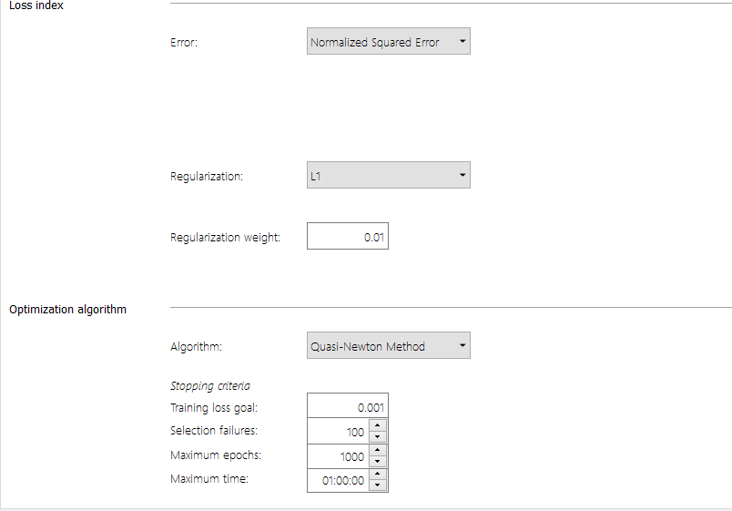
Neural Designer – Building Networks - Step 4a.
Train the network
Select the loss method
Select the optimization method
Select the stopping criteria
Source : https://www.neuraldesigner.com/learning/user-guide/design-a-neural-network#CreateApproximationProject

Slide 16

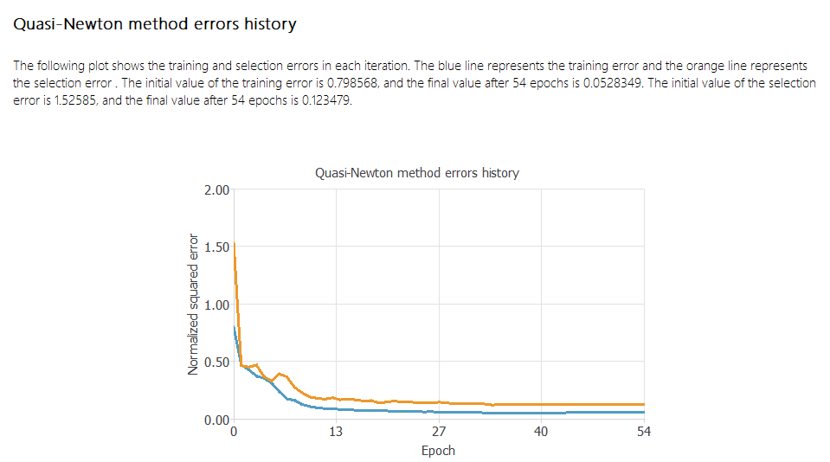
Neural Designer – Building Networks - Step 4b.
Train the network
Perform training tasks
See results
Source : https://www.neuraldesigner.com/learning/user-guide/design-a-neural-network#CreateApproximationProject

Slide 17

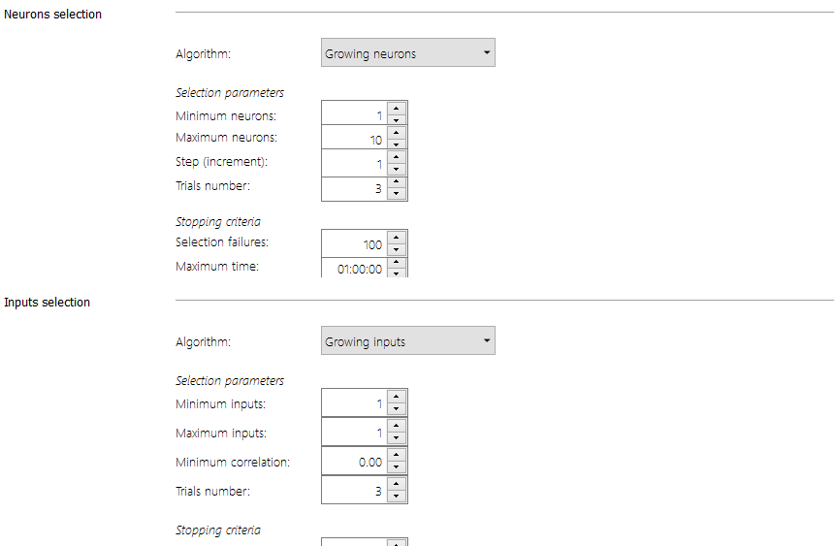
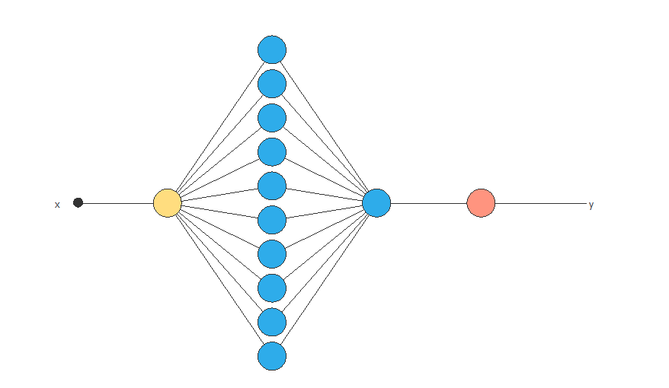
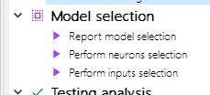
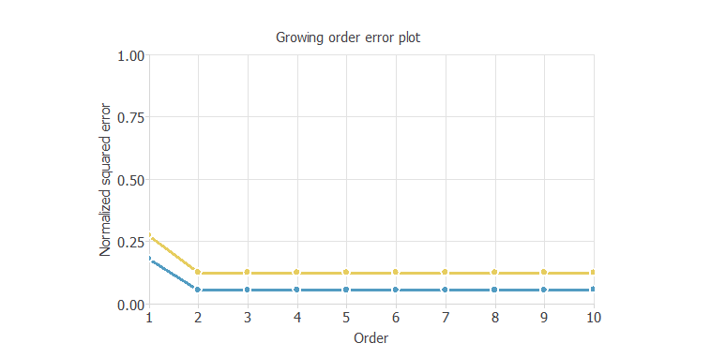
Neural Designer – Building Networks - Step 5.
Refine the network
See refining parameters
See refining results
See stopping criteria.
Perform neuron selection for refining
Get final refined network
Source : https://www.neuraldesigner.com/learning/user-guide/design-a-neural-network#CreateApproximationProject

Slide 18

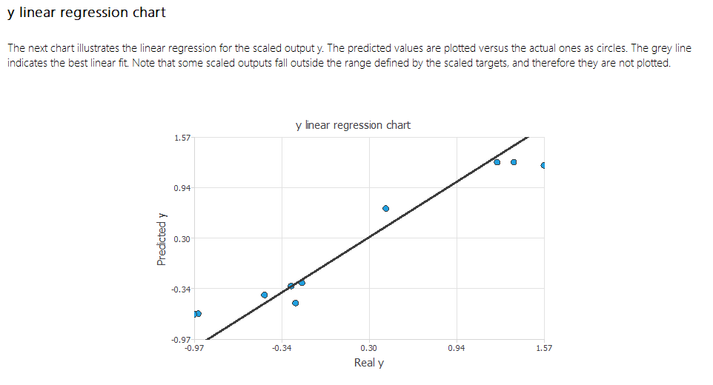
Neural Designer – Building Networks - Step 6.
Test the network
Perform linear regression analysis
Runs the tests and gives results
Source : https://www.neuraldesigner.com/learning/user-guide/design-a-neural-network#CreateApproximationProject

Slide 19
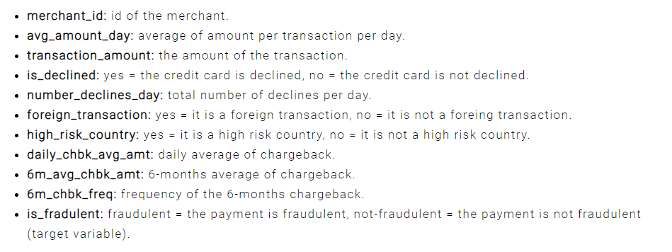
Neural Designer – Use Case – Credit Card Fraud Detection
Choose application type -> classification project
Fraudulent / Not fraudulent
Get the data set
creditcard-fraud.csv
Source : https://www.neuraldesigner.com/learning/examples/credit-card-fraud#ApplicationType

Slide 20
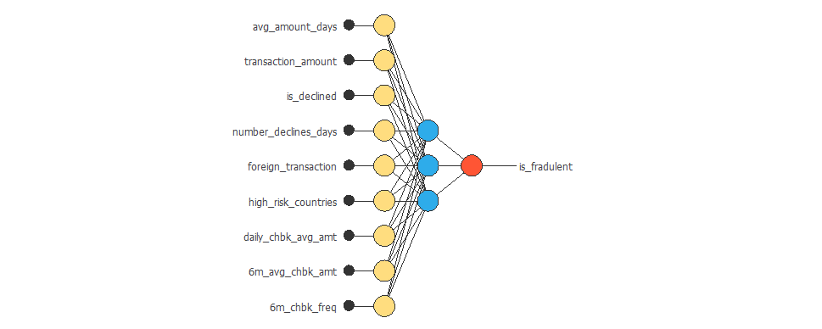
Neural Designer – Use Case – Credit Card Fraud Detection
Data instances
60% training
20% selection
20% testing
See data distribution
Balanced vs imbalanced
See the correlations
Build the network
Source : https://www.neuraldesigner.com/learning/examples/credit-card-fraud#ApplicationType

Slide 21
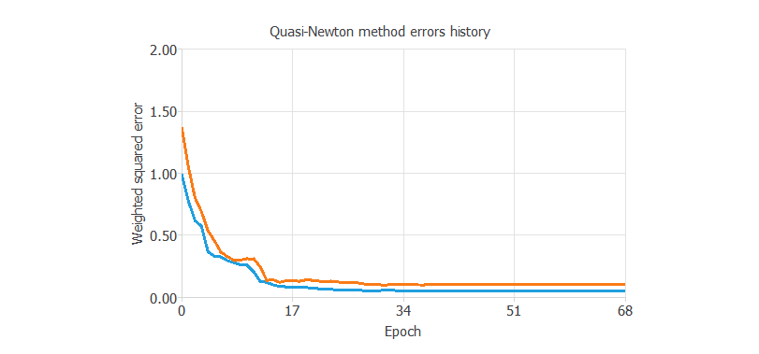
Neural Designer – Use Case – Credit Card Fraud Detection
Train the network
Loss index as default
Optimization as default
Model Selection
Order selection
Incremental model
Test the network
Source : https://www.neuraldesigner.com/learning/examples/credit-card-fraud#ApplicationType

Slide 22
References -------------------------------------------------------------
McKInsey and Company – Risk Practice : Applying machine learning in capital markets: Pricing, valuation adjustments, and market risk
https://en.wikipedia.org/wiki/Capital_market
https://www.neuraldesigner.com/learning/user-guide/what-is-neural-designer
https://www.neuraldesigner.com/learning/user-guide/technical-features
https://www.neuraldesigner.com/learning/user-guide/design-a-neural-network#CreateApproximationProject
https://www.neuraldesigner.com/learning/user-guide/design-a-neural-network
https://www.neuraldesigner.com/learning/examples/credit-card-fraud#ApplicationType

Slide 23
Topics for next session
Neural Networks – Concepts and Practical examples

Slide 24
End of Session ------------------------------------------------------------------ Questions

